Slide 1
UNIT I

Slide 2
Introduction to computer-based problem solving

Slide 3
Programming
Programming is the process of creating a set of instructions that tell a computer how to perform a task. Programming can be done using a variety of computer programming languages, such as JavaScript, Python, and C++.

Slide 4
“Instruct the computer”: this basically means that you provide the computer a set of instructions that are written in a language that the computer can understand. The instructions could be of various types.
For example:
Adding 2 numbers,
Rounding off a number, etc.
Just like we humans can understand a few languages (English, Spanish, Mandarin, French, etc.), so is the case with computers. Computers understand instructions that are written in a specific syntactical form called a programming language.

Slide 5
Why programming language required?
Computers understand instructions that are written in a specific syntactical form called a programming language.
A programming language provides a way for a programmer to express a task so that it could be understood and executed by a computer.

Slide 6
Introduction to computer-based problem solving
Requirement of problem solving by computers
Problem definition
Use of examples for problem solving
Similarities between problems
Problem solving strategies
Steps involved in problem solving

Slide 7
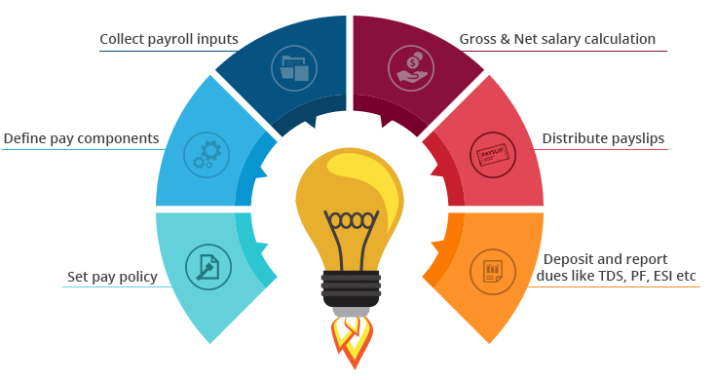
Requirement of problem solving by computers
Why computers required?
Example1: Payroll Processing System:
Speed in performing computational tasks
Versatility of operations performed
Less error-prone
Reduction in paper work

Slide 8
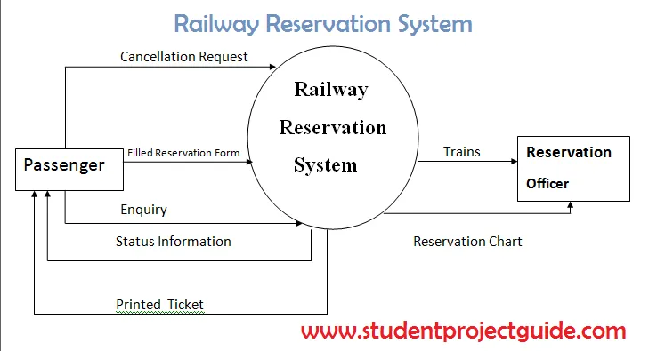
Example 2: Railway Reservation System
1. Distribution of operations
2. Efficient Search of data
3. Easy manipulation of data

Slide 9

Example 3: Controlling an Atomic power station
Accuracy of operations
Safety of the human kind
Availability of the system

Slide 10
Problem Definition
Problem definition is clear cut representation of what the user needs from a system and the task the programmer wants to accomplish through the system. Problem definition is not how to solve the problem but instead what the problem really is.
Problem definition:
Given a set of ‘n’ numbers, add the numbers and return the resultant sum. Assume n is greater than or equal to zero.

Slide 11
A problem definition should convey the following:
Input: What should be given as input to the system?
Operation: What needs to be done?
Output: What is expected output of the program?
That is Attempting the problem before understanding it, leads to solving the wrong problem.

Slide 12
Use of examples for problem solving
When we stuck with a solution for a problem, the best way to deal with is to identify an example of the general problem and try to solve that specific problem.
This gives an idea about how the problem needs to be approached.
For example finding a maximum in a given set of numbers is a very common procedure that is frequently encountered.
The process of finding a maximum among a given set of numbers can be easily identified by considering a set of n integers and finding the maximum limit in that set.

Slide 13
Similarities between problems
The problems solved meets varied purposes.
But the underlying details of the problems are similar.
Consider 2 real world applications – a pay roll processing system and railway reservation system
These two systems are applicable to different unrelated domains but they have the following common processes.

Slide 14
Searching the database for an entry
Calculation of Payroll/ticket
Likewise all applications perform certain common trivial functions. Examples are
Sorting records
Swapping
Finding the maximum or minimum
Searching Methods
String Manipulation functions
These similarities in programs give rise to reusability of code. Reusability of code is one of the strongest points of software engineering.

Slide 15
Problem solving strategies
Before we get into strategies involved in problem solving, the following things should be kept in mind:
Writing code is to be clear that is what is to be build.
Successful programs take a long time to write.
There are no cookbook strategies to replace intelligence, experience and good taste in programming
Programming is an iterative activity.

Slide 16
Different strategies to solve a computational problem
Divide-and-Conquer strategy
Dynamic programming
Back Tracking
Greedy Method

Slide 17
Steps involved in problem solving
Problem solving through computers involve the following steps
Understanding the problem
Devising a solution to the problem
Decide what is to be provided as input and the corresponding output
Design the solution
Implement the solution using an appropriate language
Test the program exhaustively

Slide 18
Program design and implementation issues

Slide 19
programs and algorithms
Program
A Program is an intermediate language which converts the programmers thoughts into machine understandable language
Algorithm
The algorithm is part of the blueprint or plan for the computer program, an algorithm is:
“An effective procedure for solving a class of problems in a finite number of steps.”

Slide 20
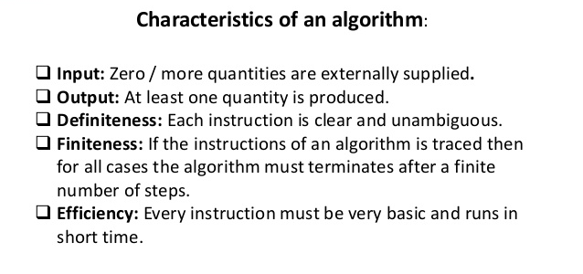

Slide 21
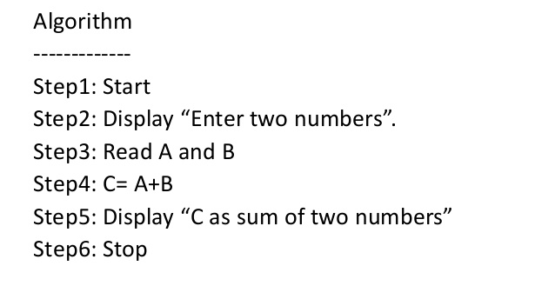
Writing Algorithms

Slide 22
Flowchart
A flowchart is simply a graphical representation of steps. It shows steps in sequential order and is widely used in presenting the flow of algorithms, workflow or processes.

Slide 23
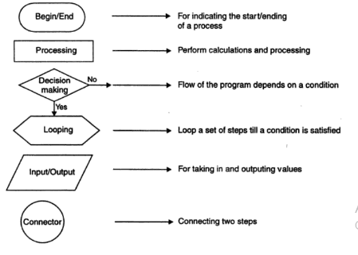

Slide 24
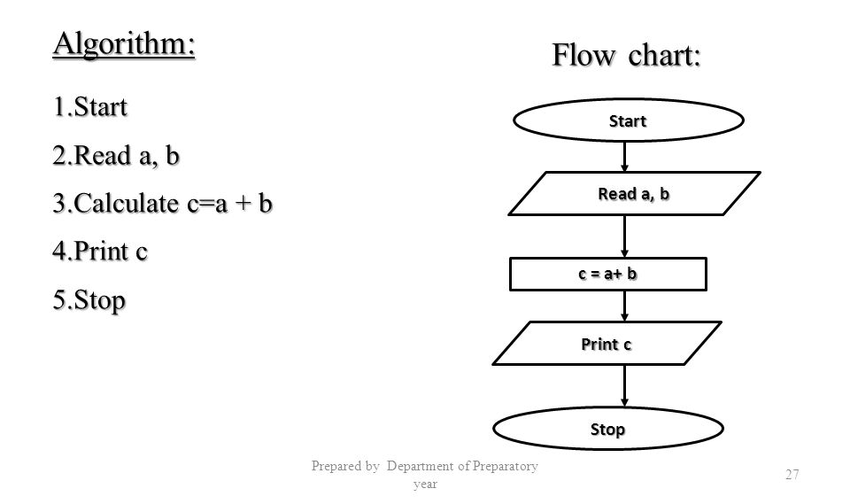
Example: Addition of two numbers flowchart

Slide 25
Implementation
Sequence:
The computer will run your code in order, one line at a time from the top to the bottom of your program.
Selection:
Sometimes you only want some lines of code to be run only if a condition is met, otherwise you want the computer to ignore these lines and jump over them.
Iteration:
Sometimes you want the computer to execute the same lines of code several times. This is done using a loop. There are three types of loops: For loops, while loops and repeat until loops.

Slide 26
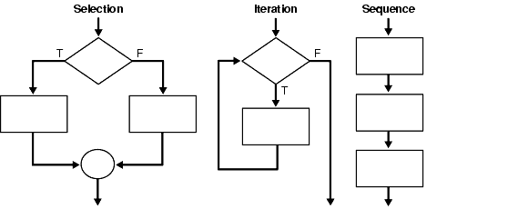

Slide 27
Testing
White Box Testing is a software testing method in which the internal structure/ design/ implementation of the item being tested is known to the tester.
Black Box Testing is a software testing method in which the internal structure/ design/ implementation of the item being tested is not known to the tester.

Slide 28
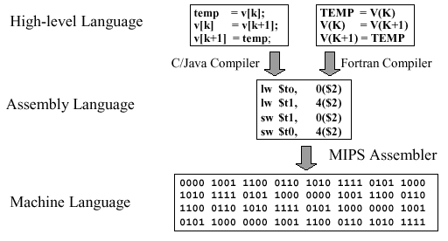
Programming Environment
Primary Classification of Programming Languages:
Machine language
Assembly language
High-level language
Computing languages are translated from source code to assembly language to machine language,
as illustrated in the diagram
Hierarchical View

Slide 29
Machine language
Machine Language is the only language that is directly understood by the computer.
It does not need any translator program.
We also call it machine code and it is written as strings of 1’s (one) and 0’s (zero).
When this sequence of codes is fed to the computer, it recognizes the codes and converts it into electrical signals needed to run it.
OPCODE | OPERAND

Slide 30
Assembly Language
Each personal computer has a microprocessor that manages the computer's arithmetical, logical, and control activities.
Each family of processors has its own set of instructions for handling various operations such as getting input from keyboard, displaying information on screen and performing various other jobs. These set of instructions are called 'machine language instructions'.
A processor understands only machine language instructions, which are strings of 1's and 0's. The low-level assembly language is designed for a specific family of processors that represents various instructions in symbolic code and a more understandable form.

Slide 31
High Level Language
High-level languages are like English-like language, with less words also known as keywords and fewer ambiguities. Each high level language will have its own syntax and keywords. The meaning of the word syntax is grammar.
It offers:
Readability
Easy Debugging
Portability
Easy software Development Example: – BASIC, COBOL, FORTRAN, PASCAL, and C.

Slide 32
A high level language program can’t get executed directly. It requires some translator
There are two types of translators for high level language programs to get it translated to machine language.
Interpreter
Compiler

Slide 33
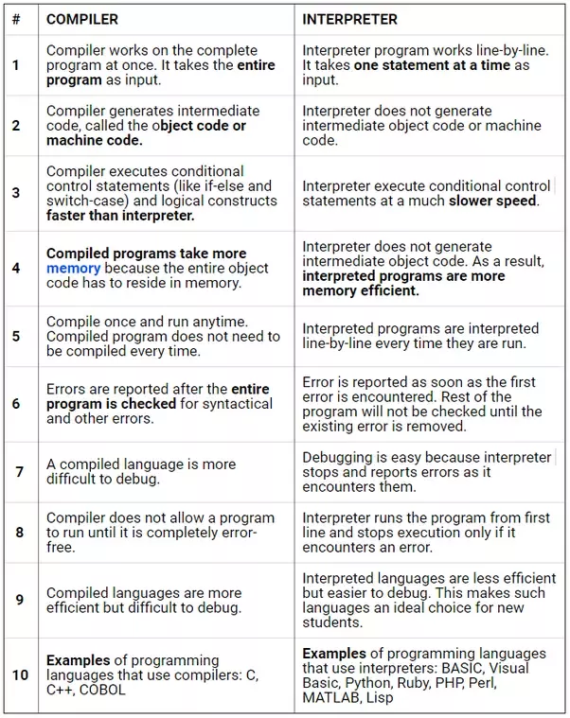

Slide 34
The following are the language before ‘c’ & various versions of ‘c’.
1. CPL (Common Programming Language)
The CPL was invented by Martin Richards at the University of Cambridge in the early of 1960s.
2. BCPL (Basic Combined Programming Language)
The BCPL was invented by Martin Richards at the University of Cambridge in the year of 1966. It was a popular programming language at that time. BCPL allows the user, direct access to the computer memory. BCPL is the extension of CPL.
3. B Language
B language is derived from BCPL. It was introduced in the year of 1969 by Ken Thompson and Dennis Ritchie at Bell Laboratory, USA. The B language is similar to BCPL.
4. C Language
C language is derived from the B language. It was introduced in the year of 1972 by Dennis Ritchie at Bell Laboratory, USA. The C language was mainly developed to create an operating system called UNIX. The name C is given based on the previous language B and BCPL. Ninety percent of the UNIX operating system code is written in C language. During the 1970s, the C language became a very popular programming language. Many universities and organizations began creating their version of C language for their respective projects. So, C language has got many variants at that time. Later it was standardized.

Slide 35
5. ANSI C (C89)
In the year of 1983, the ANSI (American National Standards Institute) formed a committee to frame standard specifications for the C language. In the year of 1989, this committee introduced a standard version of C with the name "ANSI C" with standard library files. The ANSI C is also called as C89 in short form.
6. C90
In the year of 1990, the ANSI C was got ISO (International Organization for Standardization) standardization with the inclusion of a few new features like new library files, new processor commands. And it was also added with keywords const, volatile and signed, etc... ISO standardized ANSI C as ISO/IEC 9899:1990. This version is called as C90 in short form.
7. C99
In the year of 1995, many new features were added to the C90 to create a new version of it. This new version of C was got ISO standardization in the year of 1999 with the name ISO/IEC 9899:1999. In the short form, it is called as C99. Later C99 became the official standard version of C.

Slide 36
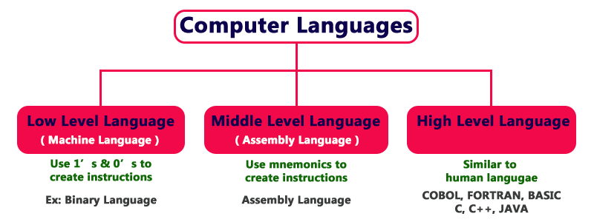
Computer languages are the languages through which the user can communicate with the computer by writing program instructions.

Slide 37
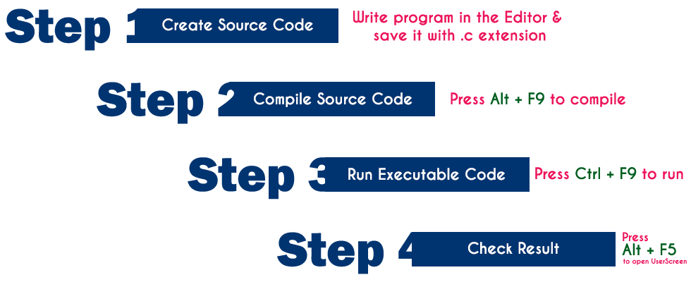

Slide 38




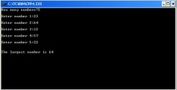

C Program Execution Process
Source Code
Compiler
Linker
Executable Code
User Screen
Object Code
abc
add
110
CRTL+F9
ALT+F5
ALT+F9
CPU
Sample.obj
Sample.exe
Sample.c
stdio.h
List of ERRORS
Header Files
4

Slide 39
Every file that contains a C program must be saved with ‘.c’ extension. This is necessary for the compiler to understand that this is a C program file. Suppose a program file is named, first.c.
The file first.c is called the source file which keeps the code of the program. Now, when we compile the file, the C compiler looks for errors. If the C compiler reports no error, then it stores the file as a .obj file of the same name, called the object file.
So, here it will create the first.obj. This .obj file is not executable. The process is continued by the Linker which finally gives a .exe file which is executable. Linker: First of all, let us know that library functions are not a part of any C program but of the C software.

Slide 40
Thus, the compiler doesn’t know the operation of any function, whether it be printf or scanf. The definitions of these functions are stored in their respective library which the compiler should be able to link. This is what the Linker does. So, when we write #include, it includes stdio.h library which gives access to Standard Input and Output. The linker links the object files to the library functions and the program becomes a .exe file. Here, first.exe will be created which is in an executable format.
Loader: Whenever we give the command to execute a particular program, the loader comes into work. The loader will load the .exe file in RAM and inform the CPU with the starting point of the address where this program is loaded.

Slide 41
Brief History of C
The C programming language was developed in the Bell Labs of AT&T by an employee called Dennis Ritchie between 1969 and 1973 while working on Unix operating system.
He created this language using ALGOL, BCPL, and B the languages that were used before C was created.
Ritchie added many powerful features to C and used it to further develop the UNIX operating system.
American National Standards Institute (ANSI) in 1983, formed a committee to provide a comprehensive definition to the C language and thus came into existence the new ANSI C language with better features.

Slide 42
What is C Character set?
C Character set is a collection of characters supported in C programming language.
C Programming language has a rich set of characters which are used to construct c program instructions.
1

Slide 43
What does C Character Set contains?
Alphabets
- C Language supports all alphabets of English. It supports both UPPERCASE & lowercase letters
Digits
- C Language supports 10 digits to construct numbers. Those 10 digits are 0,1,2,3,4,5,6,7,8,9
Special Symbols
- C supports a rich set of special symbols that include symbols to perform mathematical operations, condition checking, white space, back space, etc…
2

Slide 44
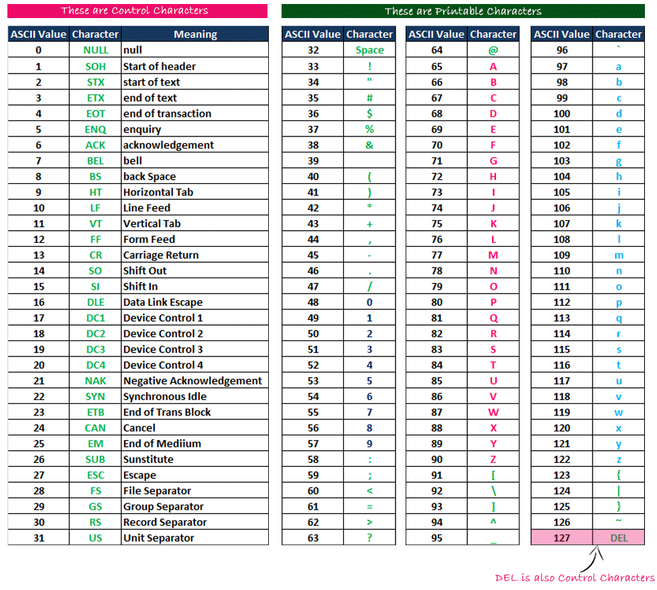
Commonly used Special Symbols with ASCII Values
3

Slide 45
A Trigraph sequences provides a way to enter certain characters that are not available on some keyboards. Each trigraph sequence consists of three characters (two question marks followed by another character) as shown below.
Trigraph sequence | Translation
??= | # Number sign
??( | [ Left bracket
??/ | \ Back slash
??) | ] Right bracket
??' | ^ Caret
??< | { Left brace
??! | | Vertical bar
??> | } Right brace
??- | ~ Tilde

Slide 46
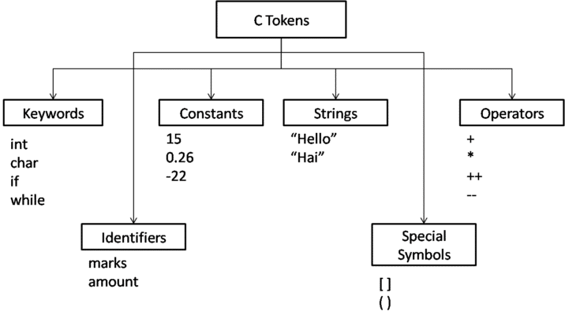
C Tokens:
In C programs, each word and punctuation is referred to as a token.
C Tokens are the smallest building block or smallest unit of a C program.

Slide 47
Keywords
Keywords are pre-defined words in a C compiler.
Each keyword is meant to perform a specific function in a C program.
Since keywords are referred names for compiler, they can’t be used as variable name.
C language supports 32 keywords which are given below.

Slide 48
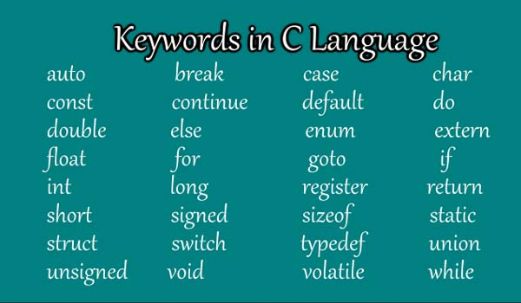

Slide 49
C Identifiers
Identifier refers to name given to entities such as variables, functions, structures etc.
Identifiers must be unique. They are created to give a unique name to an entity to identify it during the execution of the program. For example:
int money;
double accountBalance;
Here, money and accountBalance are identifiers.
Also remember, identifier names must be different from keywords. You cannot use int as an identifier because int is a keyword.

Slide 50
Rules for naming identifiers
o First character must be an alphabet (or underscore).
o Must consist of only letters(a-z,A-Z), digits(0-9) or underscore.
o Only first 31 characters are significant.
o Cannot use a Keyword.
o Must not contain white space.

Slide 51
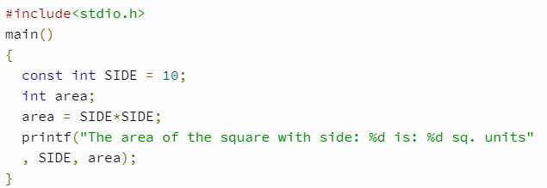
Constants
C Constants are also like normal variables. But, only difference is, their values can not be modified by the program once they are defined.
Constants refer to fixed values. They are also called as literals
Constants may be belonging to any of the data type.
Syntax:
const type constant_name;

Slide 52
TYPES OF C CONSTANT:
Integer constants
Real or Floating point constants
Octal & Hexadecimal constants
Character constants
String constants
Backslash character constants

Slide 53
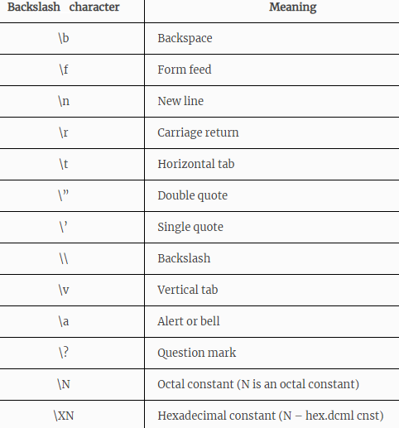

Slide 54
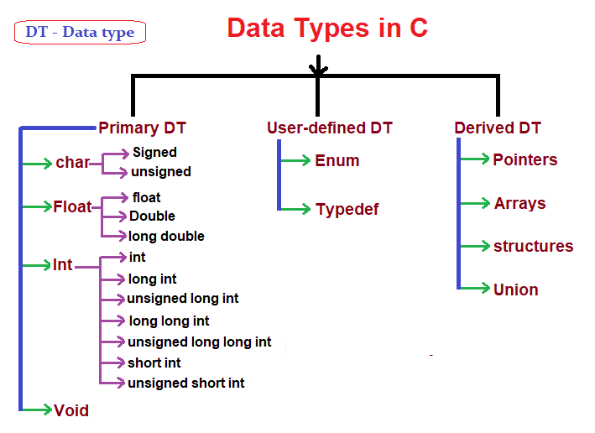
Datatypes:

Slide 55
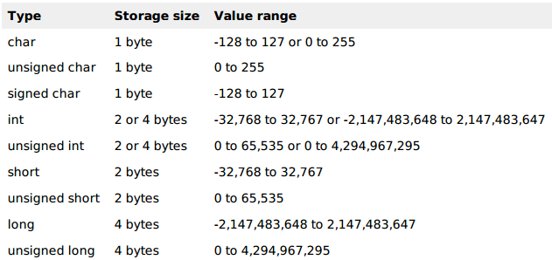

Slide 56
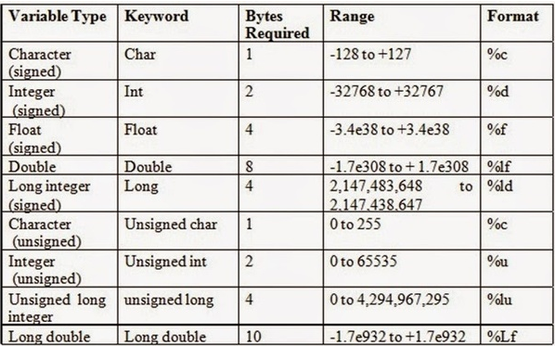

Slide 57
Void Types:
The void type has no values. It is used to represent the type of function. The type of function is said to be void when it does not return any value to the calling function.

Slide 58
Variables in C
A variable is nothing but a name given to a storage area that our programs can manipulate.
A variable definition tells the compiler where and how much storage to create for the variable.
A variable definition specifies a data type and contains a list of one or more variables of that type as follows −
Syntax:
type variable_list;
Ex: int i, j, k;
char c, ch;
float f, salary;
double d;

Slide 59
type variable_name = value;
int d = 3, f = 5; // declaration and initializing d and f.
char x = 'x'; // the variable x has the value 'x'.

Slide 60
Input/Output
Input means to provide the program with some data to be used in the program and Output means to display data on screen or write the data to a printer or a file.
The standard input-output header file, named stdio.h contains the definition of the functions printf() and scanf(), which are used to display output on screen and to take input from user respectively.

Slide 61
printf()
The printf() method, in C, prints the value passed as the parameter to it, on the console screen.
printf(“%X”, variableOfXType);
where %X is the format specifier in C. It is a way to tell the compiler what type of data is in a variable

Slide 62
scanf()
The scanf() method, in C, reads the value from the console as per the type specified.
scanf(“%X”, &variableOfXType);
where %X is the format specifier in C.
It is a way to tell the compiler what type of data is in a variable
& is the address operator in C, which tells the compiler to change the real value of this variable, stored at this address in the memory.

Slide 63
C – Operators
The symbols which are used to perform logical and mathematical operations in a C program are called C operators.
These C operators join individual constants and variables to form expressions.
Operators, functions, constants and variables are combined together to form expressions.
Consider the expression A + B * 5. where, +, * are operators, A, B are variables, 5 is constant and A + B * 5 is an expression.

Slide 64
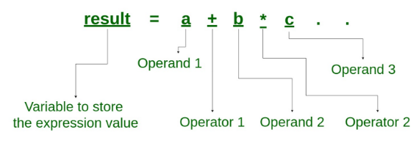
Expressions
An expression is a combination of operators, constants and variables. An expression may consist of one or more operands, and zero or more operators to produce a value.

Slide 65
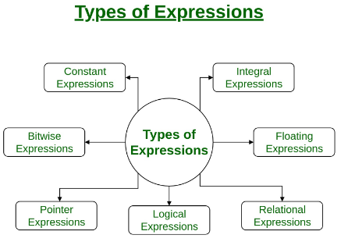

Slide 66
Constant expressions: Constant Expressions consists of only constant values. A constant value is one that doesn’t change.
Integral expressions: Integral Expressions are those which produce integer results after implementing all the automatic and explicit type conversions.
Floating expressions: Float Expressions are which produce floating point results after implementing all the automatic and explicit type conversions.
Relational expressions: Relational Expressions yield results of type bool which takes a value true or false. When arithmetic expressions are used on either side of a relational operator, they will be evaluated first and then the results compared. Relational expressions are also known as Boolean expressions.

Slide 67
Logical expressions: Logical Expressions combine two or more relational expressions and produces bool type results.
Pointer expressions: Pointer Expressions produce address values.
Bitwise expressions: Bitwise Expressions are used to manipulate data at bit level. They are basically used for testing or shifting bits.

Slide 68
Precedence and Associativity
The symbols which are used to perform logical and mathematical operations in a C program are called C operators.
These C operators join individual constants and variables to form expressions.
Operators, functions, constants and variables are combined together to form expressions.
Consider the expression A + B * 5. where, +, * are operators, A, B are variables, 5 is constant and A + B * 5 is an expression.

Slide 69
Different types of operators
Arithmetic operators
Assignment operators
Relational operators
Logical operators
Bit wise operators
Conditional operators (ternary operators)
Increment/decrement operators
Special operators

Slide 70
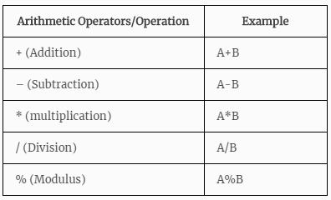

Slide 71
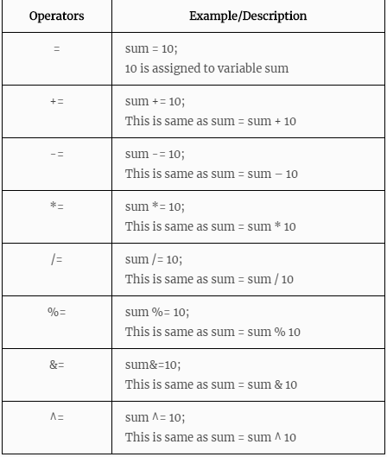
Assignment Operators

Slide 72
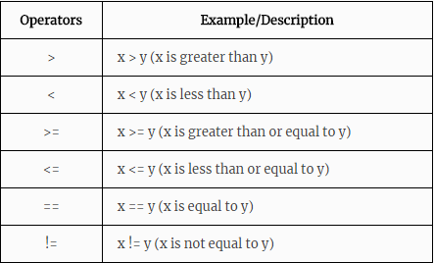
Relational Operators

Slide 73
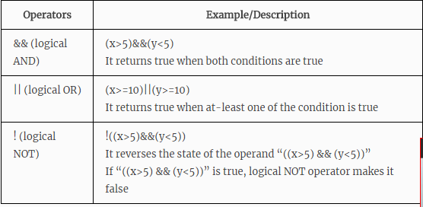
Logical Operators

Slide 74
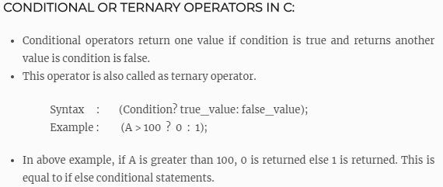
big = a > b ? (a > c ? a : c) : (b > c ? b : c) ;

Slide 75
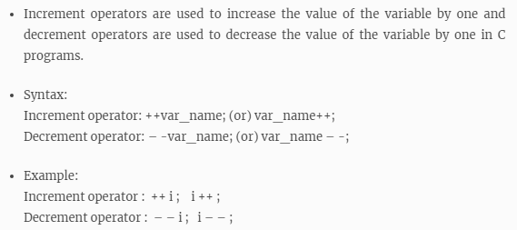
Increment/decrement operators

Slide 76
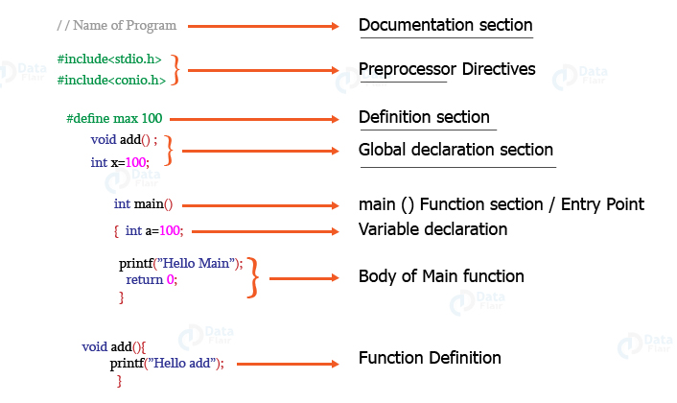
Structure of a C Program

Slide 77
//Program to add two numbers:
#include <stdio.h>
void main()
{
int number1, number2, sum;
printf("Enter two integers: ");
scanf("%d %d", &number1, &number2);
// calculating sum
sum = number1 + number2;
printf("%d + %d = %d", number1, number2, sum);
getch();
}
#include <stdio.h>
void main()
{
int num1, num2, sum;
printf("Enter first number: ");
scanf("%d", &num1);
printf("Enter second number: ");
scanf("%d", &num2);
sum = num1 + num2;
printf("Sum of the entered numbers: %d", sum);
getch();
}

Slide 78
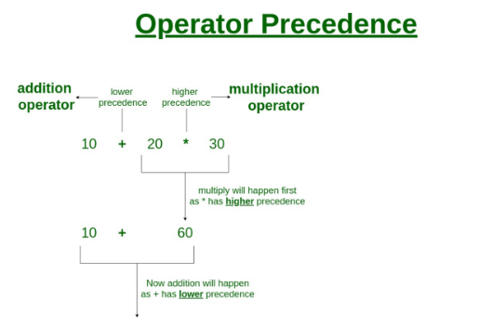
Operator Precedence in C
Operator precedence determines which operator is evaluated first when an expression has more than one operators.

Slide 79
Operators Associativity
Operators Associativity is used when two operators of same precedence appear in an expression. Associativity can be either Left to Right or Right to Left.
For example multiplication and division arithmetic operators have same precedence, lets say we have an expression 5*2/10, this expression would be evaluated as (5*2)/10 because the associativity is left to right for these operators.

Slide 80
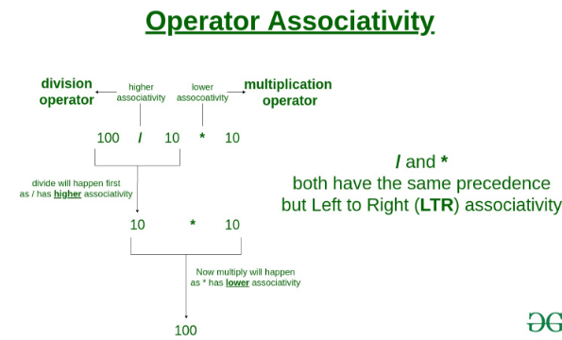

Slide 81
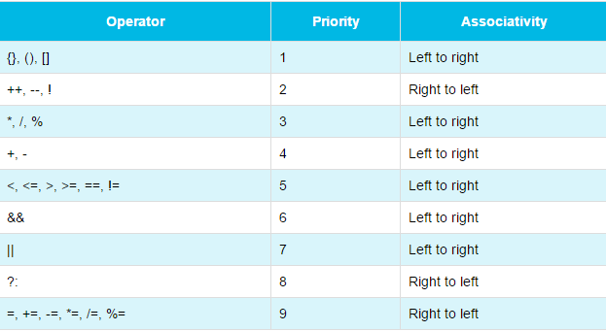

Slide 82
Evaluating Expressions
In the C programming language, an expression is evaluated based on the operator precedence and associativity.
When there are multiple operators in an expression, they are evaluated according to their precedence and associativity.
The operator with higher precedence is evaluated first and the operator with the least precedence is evaluated last.
10 + 4 * 3 / 2
4 * 3 ====> 12 12 / 2 ===> 6 10 + 6 ===> 16 The expression is evaluated to 16.

Slide 83
Write a C Program to evaluate
x= a-b/3+c*2-1;
y= a-b/(3+c)*(2-1);
z=a-(b/(3+c)*2)-1;

Slide 84
Type Conversion
Type casting refers to changing a variable of one data type into another.
Two Types
Implicit Type Conversion
Explicit Type Conversion
Advantages of Type Conversion
This is done to take advantage of certain features of type hierarchies or type representations.
It helps us to compute expressions containing variables of different data types.

Slide 85
Implicit Type Conversion
When the type conversion is performed automatically by the compiler without programmers intervention, such type of conversion is known as implicit type conversion or type promotion.
int x;
If(x>0)
{
printf("%c", x); /*Implicit casting from int to char %c*/
}

Slide 86
Explicit Type Conversion
The type conversion performed by the programmer by posing the data type of the expression of specific type is known as explicit type conversion. The explicit type conversion is also known as type casting.
Type casting in c is done in the following form:
(data_type)expression;
where, data_type is any valid c data type, and expression may be constant, variable or expression.

Slide 87
int x;
If(x>0)
{
printf("%c", (char)x); /*Explicit casting from int to char*/
}

Slide 88
Example of Typecasting
int x=7, y=5 ;
float z;
z=x/y; /*Here the value of z is 1*/
If we want to get the exact value of 7/5 then we need explicit casting from int to float:
int x=7, y=5;
float z;
z = (float)x/(float)y; /*Here the value of z is 1.4*/

Slide 89
#include<stdio.h>
void main()
{
int a = 25, b = 13;
float result;
result = a/b;
// display only 2 digits after decimal point
printf("(Without typecasting) 25/13 = %.2f\n", result );
result = (float)a/b;
// display only 2 digits after decimal point
printf("(With typecasting) 25/13 = %.2f\n", result );
getch();
}

Slide 90
Two-way selection
The two-way selection is the basic decision statement for computers.
The decision is based on resolving a binary expression, and then executing a set of commands depending on whether the response was true or false.
C, like most contemporary programming languages, implements two-way selection with the if…else statement.
An if…else statement is a paired statement used to selectively execute code based on two alternatives.

Slide 91
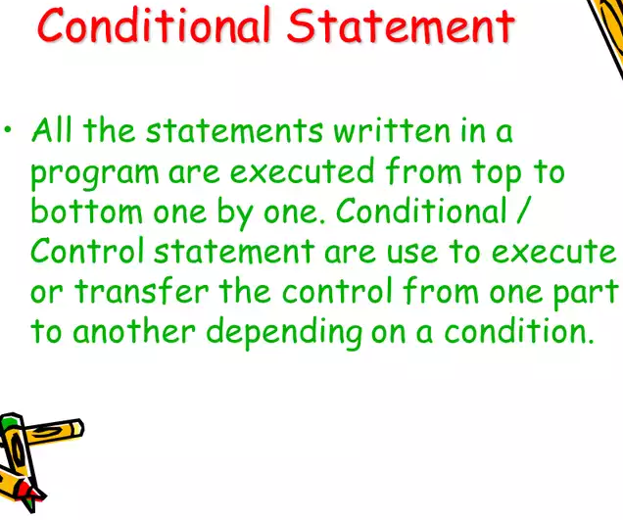

Slide 92
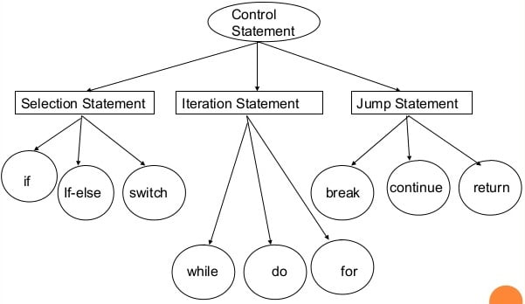

Slide 93
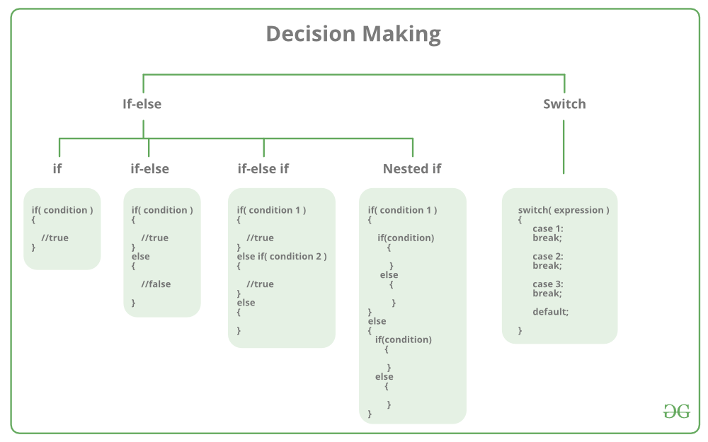

Slide 94
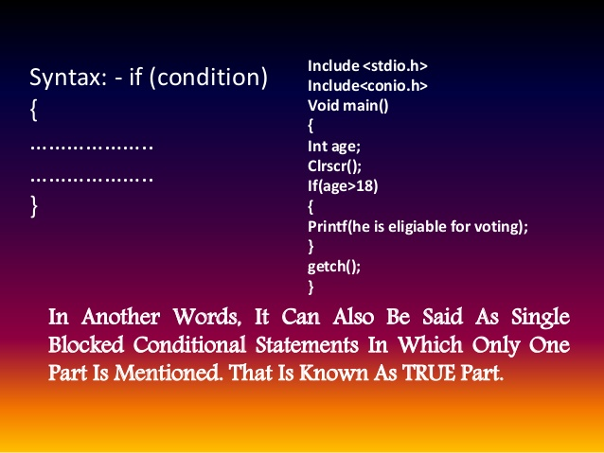

Slide 95
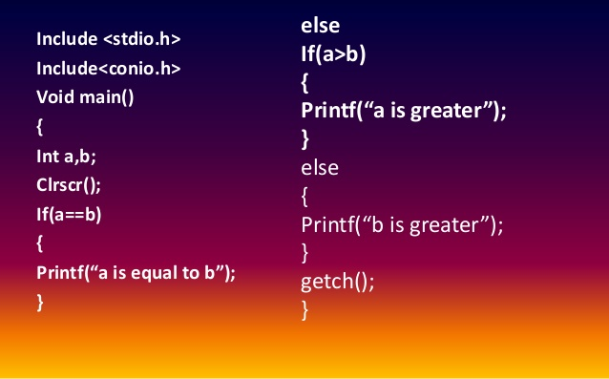
Write a program to input two numbers and print the greatest number in C

Slide 96
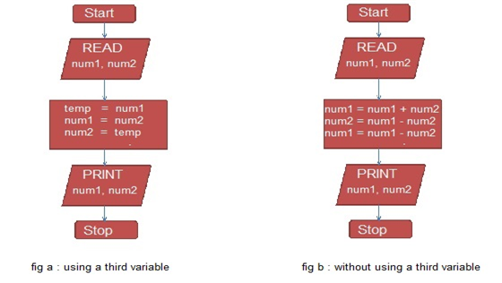
Algorithm 1: Exchange values of two variables
Step 1 : Start
Start 2 : READ values num1, num2
Start 3 : temp = num1
Start 4 : num1 = num2
Start 5 : num2 = temp
Start 6 : PRINT num1, num2
Start 7 : Stop

Slide 97
Write an algorithm and draw the flowchart to Swap two integers without using a third variable
Step 1 : Start
Start 2 : READ num1, num2
Start 3 : num1 = num1 + num2
Start 4 : num2 = num1 - num2
Start 5 : num1 = num1 - num2
Start 6 : PRINT num1, num2
Start 7 : Stop

Slide 98
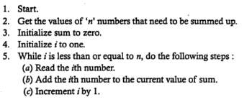

Algorithm 2: Summation of a set of numbers

Slide 99
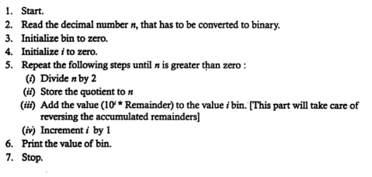
Algorithm 3: Decimal to binary base conversion

Slide 100
Program in C: Decimal to binary base conversion
#include <stdio.h>
void main()
{
int n,bin=0,rem, place = 1;
clrscr();
printf("Enter any decimal number: ");
scanf("%d", &n);
/* Decimal to binary conversion */
while(n>0)
{
rem = n % 2;
bin = (rem * place) + bin;
n /= 2;
place *= 10;
}
printf("Decimal number = %d\n", n);
printf("Binary number = %d", bin);
getch();
}

Slide 101
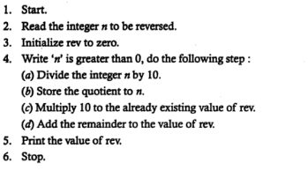
Algorithm 4: Reversing the digit of an integer

Slide 102
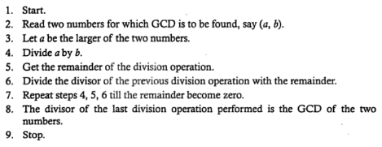
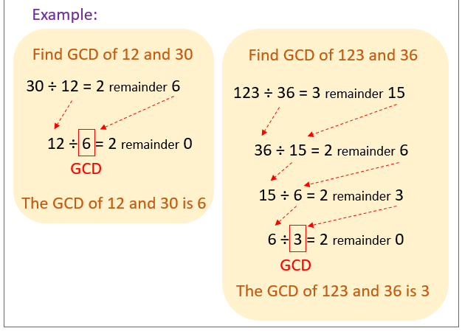
Algorithm 5: to find greatest common divisor (GCD) of two numbers

Slide 103
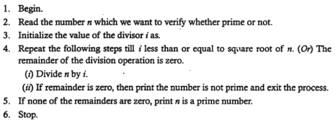
Algorithm 6: To verify whether an integer is prime or not
Step 1: Begin
Step 2: Read a number ‘n’
Step 3: Initialize the value of the divisor i
Step 4: Repeat the following until i is less than or equal to n
Check n modulus i is zero
Increment count
Step 5: Check whether count is 2
Step 6: Print n is prime
Step 7: Otherwise print n is not prime

Slide 104
C Program to find a Prime Number
#include <stdio.h>
void main()
{
int n, i, c = 0;
printf("Enter any number n:");
scanf("%d", &n);
for (i = 1; i <= n; i++)
{
if (n % i == 0)
{
c++;
}
}
if (c == 2)
{
printf("n is a Prime number");
}
else
{
printf("n is not a Prime number");
}
getch();
}

Slide 105

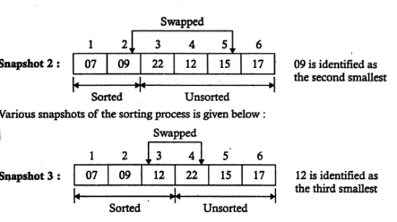
Algorithm 7: Organize a given set of numbers in ascending order

Slide 106
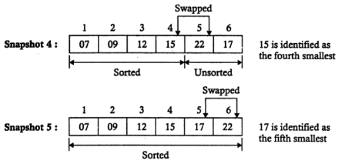

Slide 107
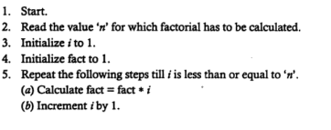

Algorithm 9: Factorial of a given number

